Slide 1
DATA REGULATION AND TECHNOLOGY COMPLIANCE
David Restrepo Amariles
Associate Professor Data Law and AI
HEC Paris
WINTER, 2021
Notes:
Welcome - and greetings to all - health
Introduce myself
New equipement make the course interactive and less monotone - keep live teaching and disccussion
course on data track

Slide 2
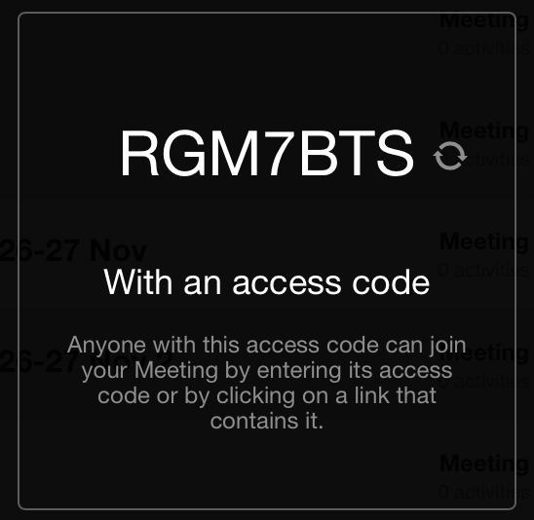
Klaxoon
https://klaxoon.com

Slide 3
Klaxoon Poll
Where do you see yourself in 10 years profession-wise (e.g. partner, in-house counsel, independent practice, investor) ?

Slide 4
“The fact of incorporating legal considerations early in the process allows us to ensure, at the moment of scaling, that we have not forgotten a step”.
Notes:
summarize the course

Slide 5
Objectives of the course
Provide a critical understanding of the key legal, technical, and socio-economic issues at stake with the use of AI and processing of data in the legal domain.
Equip students with the skills to frame legal problems into AI tasks and identify the technologies to implement them.
Develop pragmatic thinking on the use of technology in law through the design of a methodology to produce legal metrics.
For coding courses contact the Data Minds Association at HEC Paris

Slide 6
Course schedule
Session 1 - Today
Introduction to Law and AI, Guest talk by Dazza Greenwood (Lecturer and Fellow MIT Computational Law)
Session 2 - Tuesday, January 5, 9am-12pm
Data Analytics and AI, Introduction to Index Building
Session 3 - Monday, January 11, 2.30pm-5.30pm
AI and Ethics, co-hosted with A&O - Julien Sebastien and Laurie-Anne Ancenys
Session 4 - Tuesday, January 12, 9am-12pm (
AI and Partnership, co-hosted with A&O - Julien Sebastien and Laurie-Anne Ancenys
Optional Session - January 15, 6pm-7pm (hosted by Dazza Greenwood, MIT Computational Law Course)
Session 5 - Tuesday, January 26, 9am-12pm
AI and Legal Advice, co-hosted with A&O - Julien Sebastien and Laurie-Anne Ancenys
Session 6 - Thursday, January 28, 9am-12pm
Regulatory Frameworks for AI
Notes:
I want you to be able to spot problematic issues and

Slide 7
Case study
Instructions
Read the following article: David Restrepo Amariles and Julian McLachlan, Legal Indicators in Transnational Law Practice: A Methodological Assessment, 58 (2) Jurimetrics 164 (2018).
Identify the regulatory framework (state law + non state law) that applies to the variable (e.g., fixed and variable remuneration) and jurisdictions (e.g., United Kingdom and France) assigned to your group.
Generate a normative matrix for your variable and define the proxies you will used for the assessment. Use existing literature when relevant.
Identify the 5 largest companies per sector by gross global revenue in each jurisdiction (you should have then 20 companies in total).
Collect the data for each of the companies for years 2017-2019 using the resources made available by companies and regulators (financial market authorities, annual reports, companies’ website etc.). Please make sure to standardize data collected across the different sources and to use the same sources across all the companies and years. Use an excel sheet to record the data collected.
(Optional) Add external sources to complement the data collected (e.g., Reprisk). You can ask relevant databases at the HEC Learning Center.
Define a methodology to aggregate the results.
Build the index.

Slide 8
Grading
Submission 1 (50%)
Spreadsheet and Methodological Note
Excel sheet with (1) disaggregated data collection (sub-variables/proxies) (e.g., website or type of document); and (2) consolidated index.
Methodological note (3-5 pages) explaining (1) regulatory framework and (2) data collection sources and methodology.
Deadline is February 1st midnight
Submission 2 (50%)
Slide deck and Presentation (50% of course grade)
Slide deck (10-15 slides) with an explanation of the process and results.
10-minute presentation to a panel of HEC professors and lawyers from Allen & Overy + 5 min Q&A. (date TBC)
Note: You must include in the repository all the relevant documents used for data collection.

Slide 9
Submission Instructions
Please push relevant file(s) (xlxs, pdf) for submission 1 by February 1st midnight, and relevant documents for submission 2 (ppt) the day prior to your presentation by midnight.
Please crete a folder with the number of your group in the folder ‘Case Study’ and push the documents in the folder.
https://github.com/smartlawhub/TechLaw-HEC-2021-SJFI/tree/main/Case%20Study

Slide 10
First thoughts!
Group | Time
1 | 4.40pm
2 | 4.45pm
3 | 4.50pm
4 | 4.55pm
5 | 5.00pm
6 | 5.05pm
7 | 5.10pm
8 | 5.15pm
9 | 5.20pm
10 | 5.25pm
Monday
11 January
Notes:
I want you to be able to spot problematic issues and

Slide 11
Recommendation to improve class interaction and discussion
Keep camera on
Participate orally (not only through the chat), unmute mic and speak
Ask questions / share experience and thoughts
Prepare questions and interact with guest speakers
Notes:
I want you to be able to spot problematic issues and

Slide 12
Programme for Today
Introduction
SMART Law?
Legal Innovation
Mathematical Turn
Connect Case study
Github
Guest talk by Dazza Greenwood (MIT)

Slide 13
I. Introduction
A Recent Case to map the subject

Slide 14
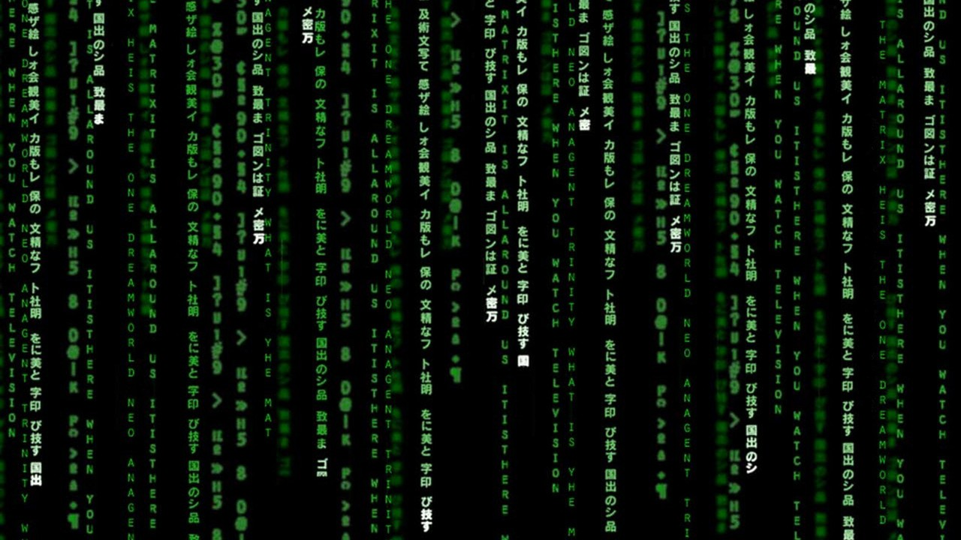
Law as code/code as law
Notes:
15 case studies (Uber riding allocation algorithm, Admission Post-bac, Youtube Content ID, Algoguard, Connect HMRC, Onderwijs Vlaanderen, google, TrustAccord, smart contracts, SIG, etc.).

Slide 15
Klaxoon Poll
Did you download a Covid-19 App?
Why did you download it?
Why did you not download it?

Slide 16


COVID-19 Contract-Tracing Apps!

Slide 17


Slide 18
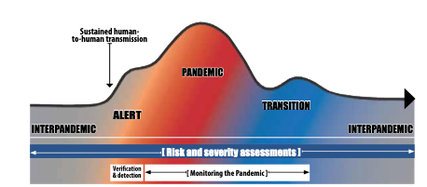

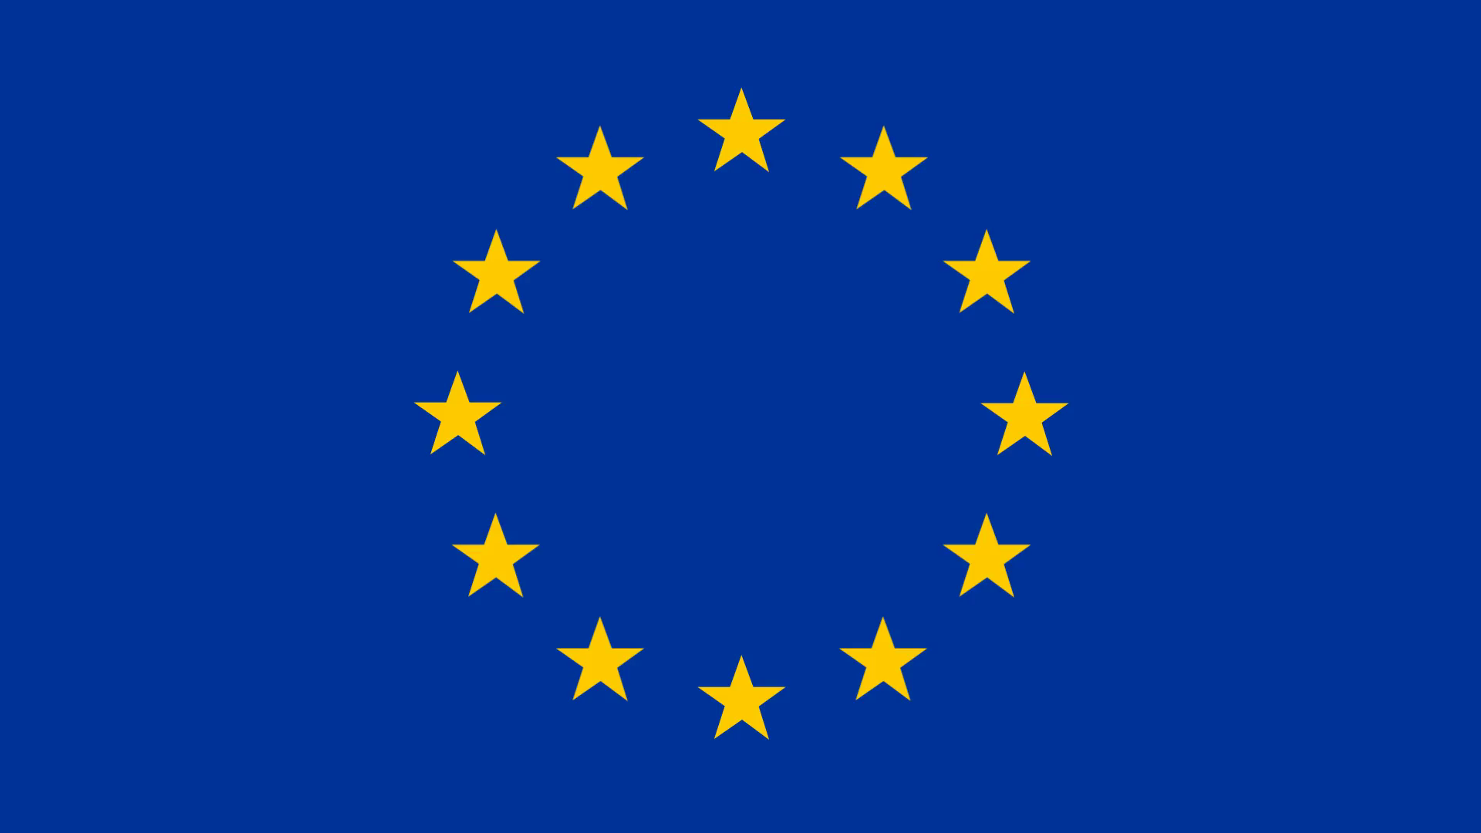
Contact Tracing Apps: Shaping Epidemiological Surveillance
Surveillance System for Public Health
[WHO 2005 Regulations]
“surveillance” means the systematic ongoing collection, collation and analysis of data for public health purposes and the timely dissemination of public health information for assessment and public health response as necessary.
[EU Law Decision 1082/2013] “epidemiological surveillance’ means the systematic collection, recording, analysis, interpretation and dissemination of data and analysis on communicable diseases and related special health issues”
[WHO 2005 Regulations, 2017 Influenza Pandemic] Objective : “Prevent, protect against, control and provide a public health response … in ways that avoid unnecessary interference with international traffic and trade”.
Surveillance phases:
Verification and detection
Risk and severity assessment
Monitoring the pandemic
Notes:
Settting the context: Surveillance for public health purposes is a regulated domain both internationally and locally, including throught EU law

Slide 19






Pandemic Surveillance: Using an app?
What is it?
Pandemic surveillance [WHO 2007, 2017]
App Generation!
Trace-Test-Treat
Components
Objectives
track the geographical spread of the virus
track the trend of disease
A
B
Mobile Application
Web Application
Data Platform
Call-Centre (Manual Tracing)
Characteristic of a Surveillance system
outbreak detection
Rapid data collection
Analysis
Assessment
timely reporting
Contact tracing
A
Notes:
We are in times of App! This is why we think of an app for the COVID pandemic
WHO guidance for surveillance during an influenza pandemic (update 2017)
here is not doubt that the question of why an APP is not because we are in times of COVID or a global pandemic, but because we are in times of Apps. Thefore, It is natural and almost instintive to think about what an App can do in these circumatances.
The tools and mechanisms for addressing public health issues is heavivly regulated. WHO, EU and national and subnational
WHO Interim Protocol:- Rapid operations to contain the initial emergence of pandemic influenza Updated October 2007

Slide 20





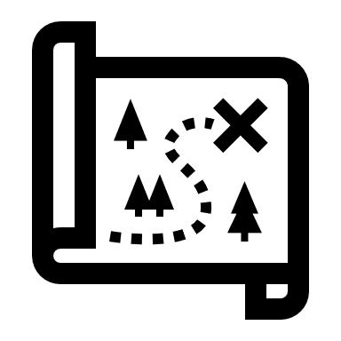


Technology Choice: Bluetooth Tracing
Exposure notification
1. Anne gets diagnosed Covid+.
A
2. She decides to share her data.
Her phone assembles the Daily keys
that span the days since she was
possibly infected (e.g. 14 days).
No data about location is shared.
A
Notification received by Bob is untraceable and no one knows he received it.
3. EN server collects all the Daily
Keys from all infected people. Bob‘s
phone then downloads the
collections of ALL keys.
B
Tracing is impossible due to encryption.
4. Bob‘s phone generates Eid keys
from each Daily key. If any Eid key
matches any saved one in Bob‘s
Phone that means he was exposed.
A-Eid

Slide 21



Technology Assessment - GAEN
Vocabulary
Bluetooth handshake (of Google/Apple solution)
Anne and Bob
meet for 10 minutes
3. Every 15 minutes
new Eid is created (144 per day)
Daily key
Generated every 24 hours.
Used as a master-key for the given day
used to generate Encounter IDs
(and to decrypt them)
A
A
A
A-Eid2
A-Eid1
Encounter ID (X-Eid)
Generated every 15 minutes.
Main information sent by Bluetooth (BT)
A-Eid
> 2m
Bluetooth handshake
An act of data exchang of two phones
Signal strength a proxy for proximity
B-Eid
B-Eid2
B-Eid1
Exposure notification server
A server that is used to upload
and distribute exposure notifications
B
B
B
2. Their phones Exchange encounter IDs
and some metadata (e.g. signal strenght)

Slide 22
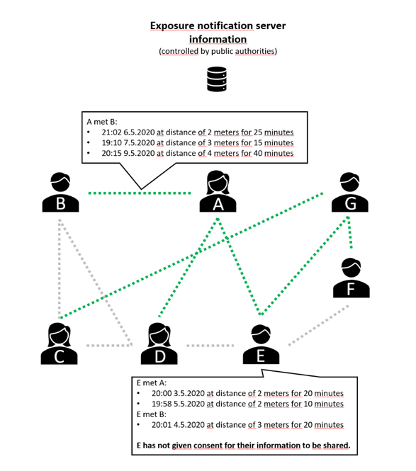
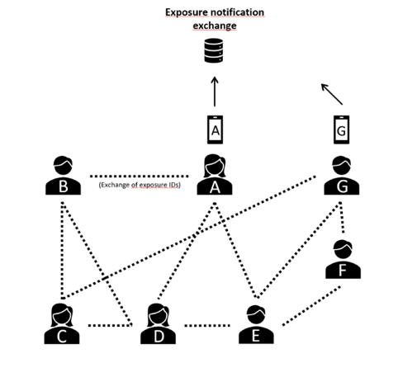
GAEN v. Tous Anticovid
X1+X2+Xn (EB-IDs)= Permanent ID
Notes:
ROBERT uses ephemeral Bluetooth IDs that change every 15 minutes. For example, if you’re talking with someone for 10 minutes, you’re going to regularly send your ephemeral Bluetooth ID to the other person, and you’re going to receive the other person’s ephemeral Bluetooth ID. If nobody gets infected with COVID-19, those IDs remain on your device (and might even get purged after a while).
if a user is diagnosed COVID-positive and gives their consent to help the community of other app users, the app will upload the list of ephemeral Bluetooth IDs of other users that they’ve been interacting with over the past 14 days.

Slide 23
Centralized vs decentralized systems
Data distribution between server/phone
2.Status verification
Decentralized
GAEN
Centralized- Tous AntiCovid
Criticism
Server owner knows who got sick.
Server owner is capable of creating social graphs.
Server owner can also track IP addresses of phones communicating with the server.
Through social graphs and phone identification it can be possible to infer „who met who“.
Function creep (i.e. use of technology beyond its stated purpose) is likely as such data can be highly useful in other applications.
Criticism
Computational limits of phones might be crossed if massive adoption happens
Server owner can track IP addresses of phones communicating with the server (but no social graphs can be made).
Can be subject to trolling, fake notifications, and other attacks.
Gives very little information to the user - validity of exposure is difficult to judge (e.g. possible „exposure“ through a wall, or in car on red lights).
Health authority has no data on notifications or their statistics.
Notes:
When you download a ROBERT-based contact-tracing app (such as France’s Stop Covid app that is in the works) and launch it for the first time, the server is notified. The server generates and sends a permanent ID and a list of ephemeral Bluetooth IDs. The server also keeps a list of all temporary IDs associated with permanent IDs.
In other words, the authority has a giant database of all permanent and ephemeral IDs associated with all app users. While the specifications say “the stored information are ‘anonymous’ and, by no mean, associated to a particular user,” it’s in no way anonymous. It’s pseudonymous.
When a user is diagnosed COVID-positive and accepts to share a list of the ephemeral Bluetooth IDs of people they’ve interacted with, the server logs all that information and increases the risk score of people they’ve interacted with.
Over time, multiple users who are confirmed to be infected with COVID-19 could flag different Bluetooth ephemeral IDs that belong to the same user. The server is going to increase the risk score of the permanent ID associated to that user.
Essentially, the authority will have a database of permanent IDs with each ID representing one person. There will be a risk score associated to each person. When the risk score reaches a certain threshold, the user is notified.

Slide 24
Infrastructure of Global Surveillance v. Digital Sovereignty (France)
UN Special Rapporteur on Extreme Poverty and Human Rights: Emergence and expansion of ”Digital welfare state”
Public authorities have a hard time rolling back exceptional powers, especially as they concern surveillance and risks that are hard to predict (e.g. terrorisms, epidemic outbreaks)
Alignment between public and private actors for information-intensive surveillance
e.g. Federal Privacy Legislated aborted in 2001 due to 9/11 ”state of exception” and ‘total information awareness’ (ITA )
USA- Tech (Google) implicit alliance to develop surveillance capabilities
State of exception for the new market form of surveillance capitalism to grow and evolve” (Shoshana Zuboff)
Increased Capabilities of Google and Apple
Eric Schmidt (former Google CEO) “the coronavirus pandemic will make big tech even bigger
Apple: iOS 13.7 and later versions “can inform people of potential exposure to COVID-19 without a dedicated Exposure Notifications app.” (Apple, 2020).
Notes:
Expansion of the purposes of contact-tracing beyond original scope and timeframe
[Korea, 01/04/20] wristbands to verify quarantine. People were leaving their phones at home to trick government app.
[UK, 20/03/20] Emergency powers to authorise health data sharing with third (tech) parties to fight COVID-19
[UK, NHS DPIA 06/05/20] Reidentification of individuals for other purposes
[Belgium, 20/05/20] Doctors requested to feed in manual contact-tracing centre (vs. Duty of confidentiality)
[Belgium] Combination of digital and manual tracing
[New Zealand, DPIA 15/05/20] Reidentification of individuals outside of the application
[Canada, MILA 23/05/20] Infection prediction
4 MAI 2020. - Arrêté royal n° 18 portant création d'une banque de données auprès de Sciensano dans le cadre de la lutte contre la propagation du coronavirus COVID-19

Slide 25
Law into technologies
Enforcement of Pandemic Mitigation Restrictions (PMRs)
Define a person’s rights and obligations
Enforce quarantine and lockdowns (e.g. Poland + face recogition/ Korea + Wristband)
Isolation monitor (e.g. UK) and Prioritize testing (e.g. Belgium)
Vaccination app?
Technology choice
Centralized v. decentralized storage and analysis
Bluetooth vs.+ + location
GAEN v. local protoctol (ROBERT in France)
Epidemiological model
The app defines the empidemiological status
Length of contact, distance, location, context, etc.
Possibility of infection prediction
Computational Indicators
France – Risk approach to notification of “at risk”
Canada – Aggregate data to predict ”spread zones”
Notes:
In Poland, in addition to the CTA ProteGO Safe, the government introduced a compulsory app (Kwarantana domowa) for enforcing quarantine measures. The app uses data such as a person’s ID, name, residence address and photo, and relies on “geolocation and face recognition technology to ensure that relevant people are quarantined” Norton Rose Fulbright, 2020b)

Slide 26
Notes:
https://www.komando.com/tech-tips/apple-your-iphone-is-secretly-mapping-you/465598/
Want to know how to access it and, if you’d like, turn it off? Here are your steps:
Open your iPhone’s settings
Tap on Privacy
Select Location Services
Then tap System Services
Scroll down until you see Significant Locations and tap on that
After entering your password or opening up your phone with FaceID, you’ll see a list of locations you’ve visited. Now, some of them may seem a bit off to you, but that’s because the location is not always precise.
Tap on a place and it will open up a page with more specifics, including a map that shows where it thought you were. Even if it didn’t peg you exactly right, it will have you in the area.
You can turn it off
Individually, you can edit locations so they will no longer be stored in your phone. To do that, tap on any city it had you in and then, on the next screen, tap on the “Edit” button in the upper right-hand corner.
That will bring about a red circle next to the location, which you could then tap on to remove it.
Then again, if you’d like to turn off Significant Locations altogether, you just need to scroll to the top of the page that lists the city locations and tap on the green button on the top-right in the tab.
Why does the phone track us like this?
According to Apple, this feature exists so that the phone can learn the places that are significant to us and therefore be able to provide personalized services, like predictive traffic routing and improved Photos Memories.
That said, it certainly seems like an invasion of privacy and one that could lead to some real problems. If the phone is tracking our whereabouts, who else may know about them?
According to Apple, no one. It says the data that goes between your cloud-connected devices is encrypted. Unless someone steals your phone and password, there is nothing they can do to access it.

Slide 27
SMART LAW - TECHLAW
Scientific, Mathematic, Algorithmic, Risk and Technology driven law

Slide 28
2˚C EU Climate Target (S)
2˚C
IPCC
EEA-TF
Ad hoc group
UNFCCC COP
DG JRC
Dutch group
Council
Academia
German WBGU
Science Policymaking
More about this: J. Rachlinski, “Evidence-Based Law” (2011), 96 Cornell L. Rev. 901,

Slide 29
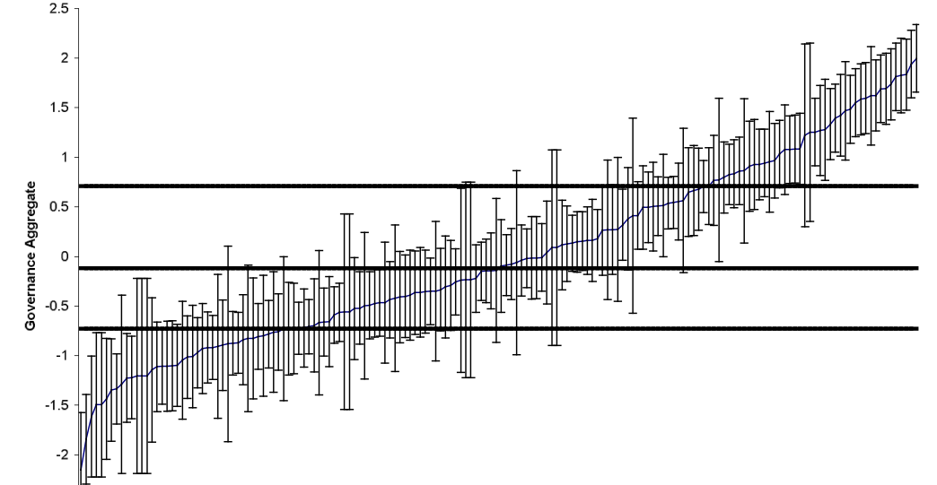
Rule of Law (M)
Equation 1
Equation 2
Equation 3
Notes:
Before Click: Daniel Kaufmann and his colleagues from the World Bank Institute claimed that any of the six variables of governance they identified, including the Rule of Law, could be measured through an statistical tool know as unobserved components model (UCM).
Click 1: The model allows the combination of numeric data from already existing sources into a single figure. For 2011, they used 24 different data sources from commercial business information providers, non-governmental organisations, survey firms or households, and public sector data providers
Click 2: From each of the sources, the authors selected a number of variables they deemed representative of the definition provided of the Rule of Law. The assumption is that each source, and thus each of its selected variables, gives “an imperfect signal of some deeper underlying notion of governance that is difficult to observe directly”, in our case, the Rule of Law.
Click 3: For example, for the Bertelsmann Transformation Index, the individual scores of ‘Separation of powers’, ‘Independent Judiciary’ and ‘Civil rights’ are averaged. The resulting figure will be used as the score of the overall source Bertelsmann Transformation Index. The calculation of the estimate of the Rule of Law for each country is not as simple as it looks here. It is actually a three-step aggregation process.
Click 4: From a mathematical point of view, Kaufmann and his colleagues assume it is possible to write the observed score for the Rule of Law in country j from the relevant data in source k, yjk, as a linear function of unobserved governance in country, gj, and a disturbance term εjk. Rememer that they are trying to extract from each source the signals they have about the Rule of Law – so what they do here is they apply this formula to each source to extract its value for the overall Rule of Law measurement. Doing this implies a series of additional statistical operations that I don’t have the time to develop here. In brief they use other statistical operations to calculate αk and βk which are components that serve to rescale the values of the source, lets say one sources gives its scores in 0-5 and others in 1-6. They are calculated differently if they are representative or non-representative sources.
In regards to gj, they assume it is a normally-distributed random variable with mean zero and variance one. They also assume that εjk has normal distribution and mean zero and a variance that is the same across countries, but differs across indicators.
The error term εjk captures two sources of uncertainty in the relationship between true governance and the observed indicators. First, the particular aspect of governance covered by indicator k could be imperfectly measured in each country, refl ecting either perception errors on the part of experts. Second, the relationship between the particular concept measured by indicator k and the corresponding broader aspect of governance may be imperfect. For example, even if the particular aspect of corruption covered by some indicator k, (such as the prevalence of ‘improper practices’) is perfectly measured, it may nevertheless be a noisy indicator of corruption if there are diff erences across countries in what ‘improper practices’ are considered to be.
Click 5. The second is the actual formula used to calculate the aggregate indicator. Here we used the concept of likelihood. The likelihood that gj happens given the population available for the Rule of Law in that country is obtained as a weighted average of the rescaled sources available for that country. Interestingly re weighted according to the strength of their correlation with one another.
Click 6: Finally, a crucial observation however is that there is unavoidable uncertainty around this estimate of governance, Th ese standard errors are essential to the correct
interpretation of our estimates of governance, as they capture the inherent uncertainty is measuring governance

Slide 30
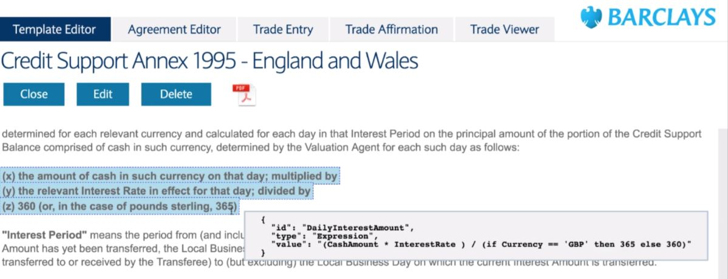
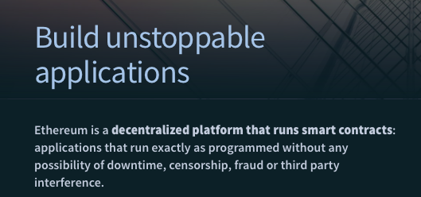
Smart Contracts (A)

Slide 31

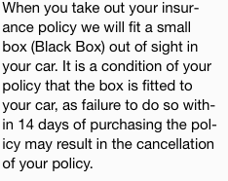
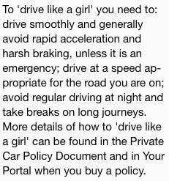
INSURANCE (R)
Notes:
http://www.osfi-bsif.gc.ca/Eng/fi-if/rg-ro/gdn-ort/gl-ld/Pages/e18.aspx

Slide 32
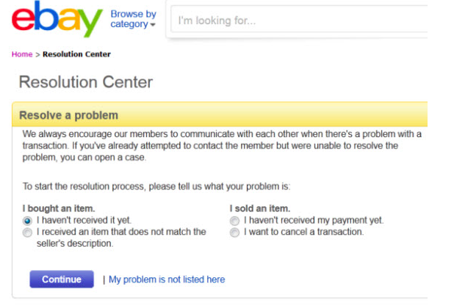
ODR (T)

Slide 33
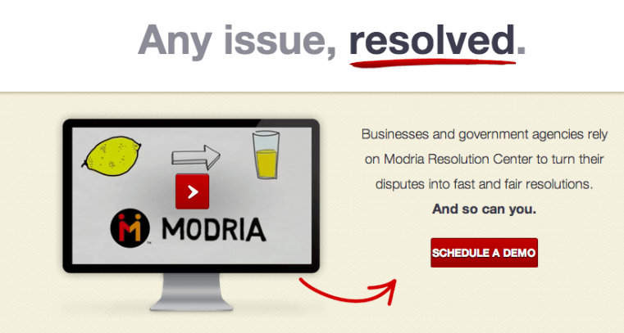
ODR (T)

Slide 34


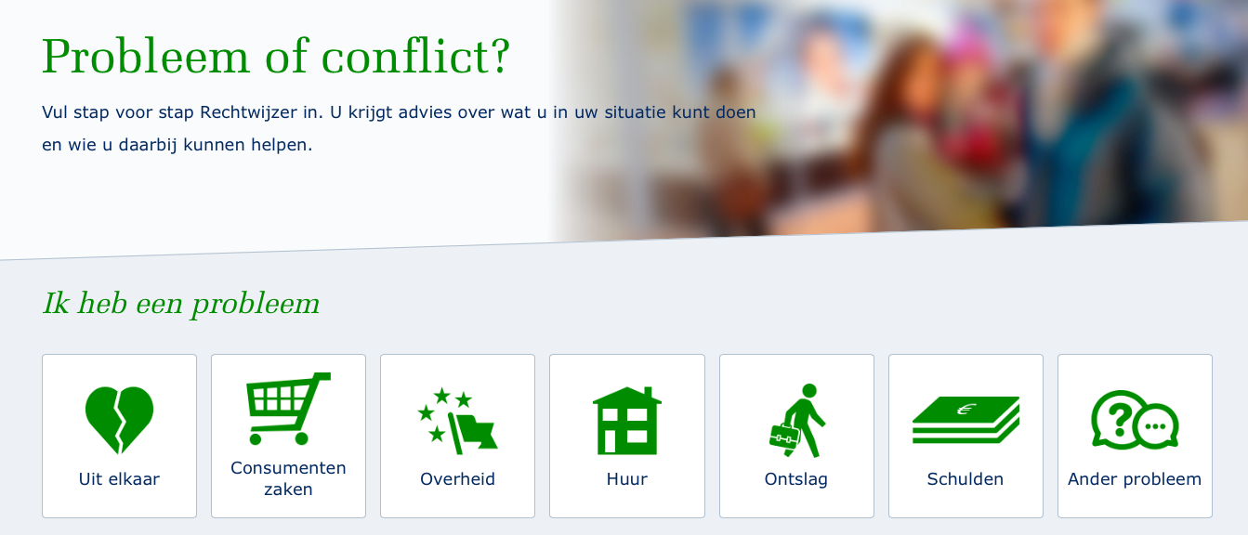
ODR (T)

Slide 35
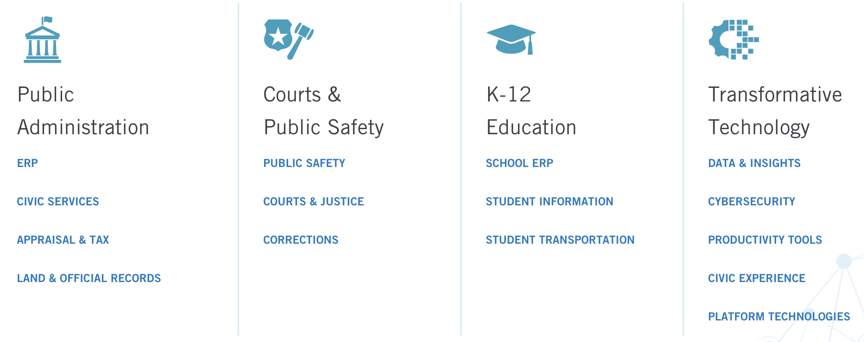
ODR (T)
Tax Dispute Resolution
Durham County, North Carolina;
Alachua County, Florida;
Orleans Parish, Louisiana;
Davidson County, Tennessee
Ohio Board of Tax Appeals

Slide 36
Global Standardization
Legal Transplant (Watson)
Law « Plug-and-Play »

Slide 37
Compliance (T)
Restrepo Amariles, D. & Winkler, M., "U.S. Economic Sanctions and the Corporate Compliance of Foreign Banks”, The International Lawyer, November 2018, vol. 51, n° 3, pp. 497-535.

Slide 38

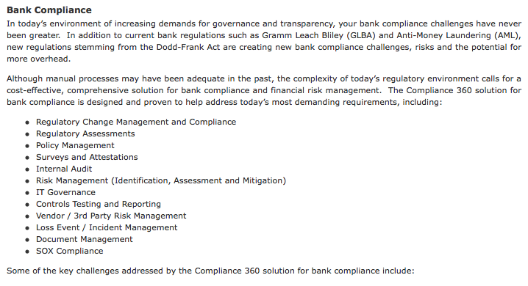
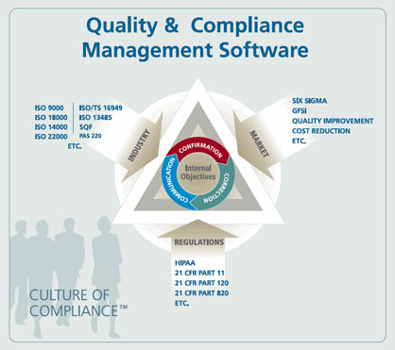
Compliance (T)

Slide 39
Why should Lawyers care about Smart Law ?

Slide 40
Klaxoon Poll
Do you have a background in coding?
Do you have a background in mathematics and statistics?

Slide 41
Why should Lawyers care about Smart Law ?
Market
New skills
Critical self-awareness
Legal innovation

Slide 42
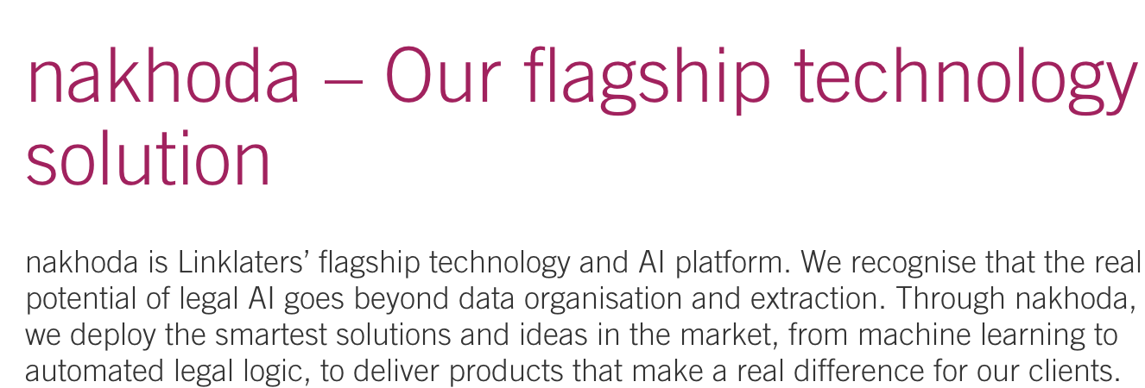

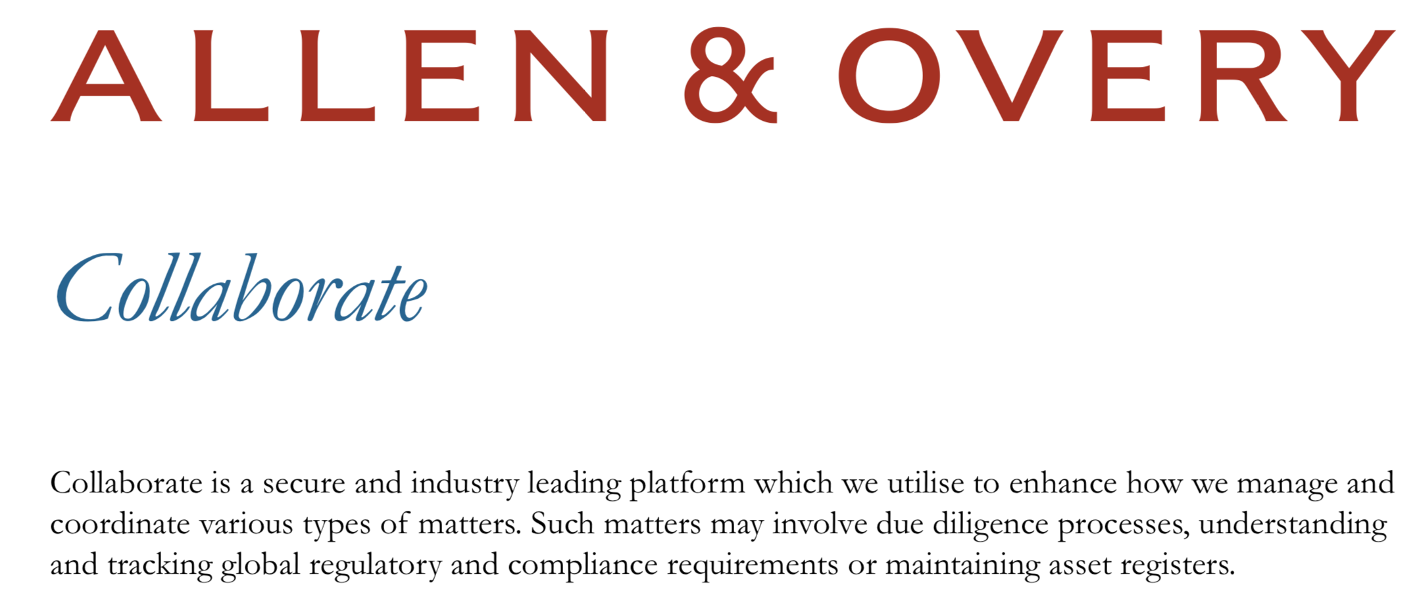

Legal Innovation ?

Slide 43
Mathematical Turn
Notes:
Consequently, he placed mathematics and physics in different realms of knowledge, each of them requiring different intellectual capacities. Aristotle, Nicomachean Ethics para. 1142a, at 16-19 (Hackett Publishing repr. 1999).

Slide 44
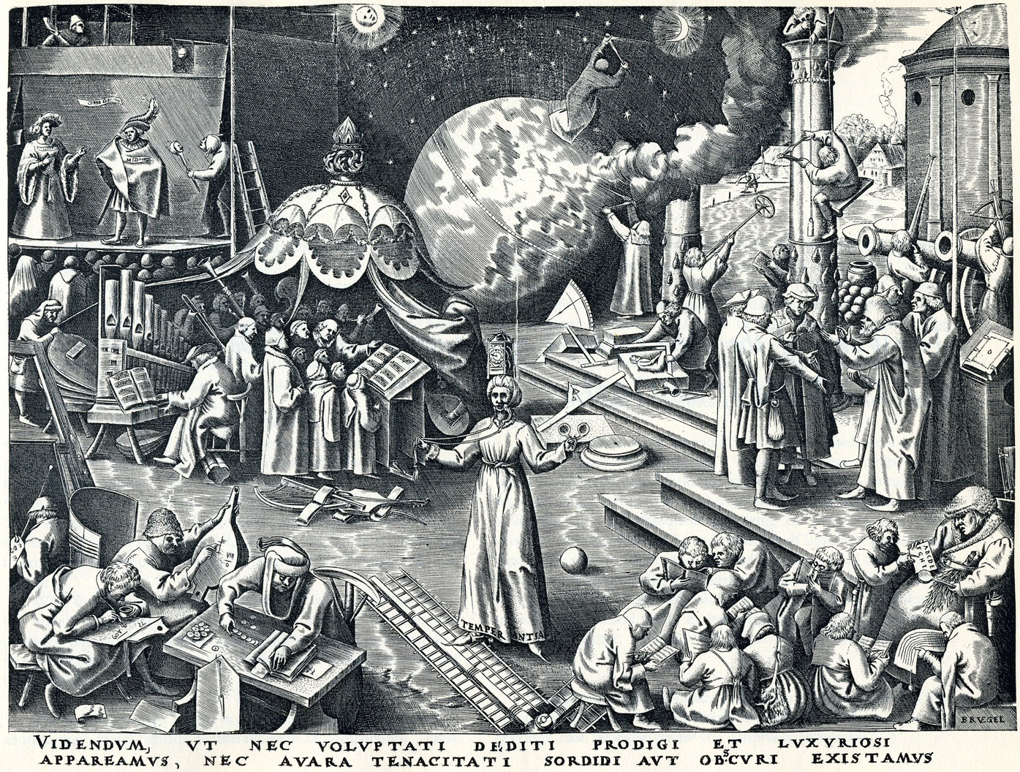
Pieter Breughel the Elder, Temperantia (c. 1560)

Slide 45

For the rational study of the law the black letter man may be the man of the present, but the man of the future is the man of statistics and the master of economics
Oliver W. Holmes, The Path of the Law, 10 Harvard Law Review 457 (1897)

Slide 46
« The next step forward in the long path of man’s progress must be from jurisprudence (which is mere speculation about law) to jurimetrics— which is the scientific investigation of legal problems . . .
The inescapable fact is that jurisprudence bears the same relation to a modern science of jurimetrics as astrology does to astronomy, alchemy to chemistry, or phrenology to psychology. »
Lee Loevinger (1949), “Jurimetrics: The next step forward”, Minnesota Law Review, vol. 33, no. 5, April, pp. 455–93.

Slide 47
The objects of mathematics are abstractions, while the first principles of these other subjects [philosophy and physics] come from experience
Aristotle, Nicomachean Ethics para. 1142a

Slide 48
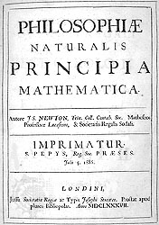
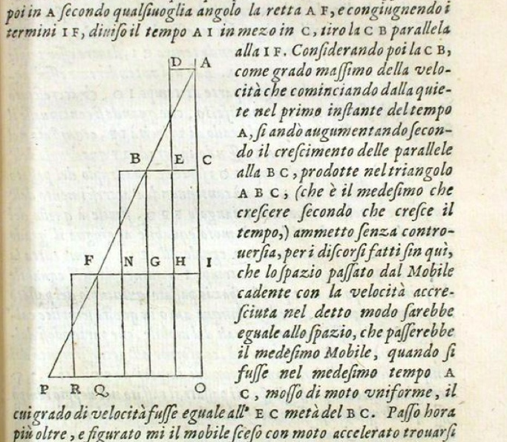
Mathematisation of Physics!
Galileo's Discorsi (1638)
Newton’s Mathematical Principles of Natural Philosophy (1687)
Notes:
The area of any triangle is 1/2 (height) x (base). So distance s is 1/2 (height, v) x (base, t) s = 1/2vt. http://practicalphysics.org/using-speed-time-graphs-find-equation.html
http://kvmagruder.net/hsci/08-14thCentury/sources/OresmeMST.html

Slide 49
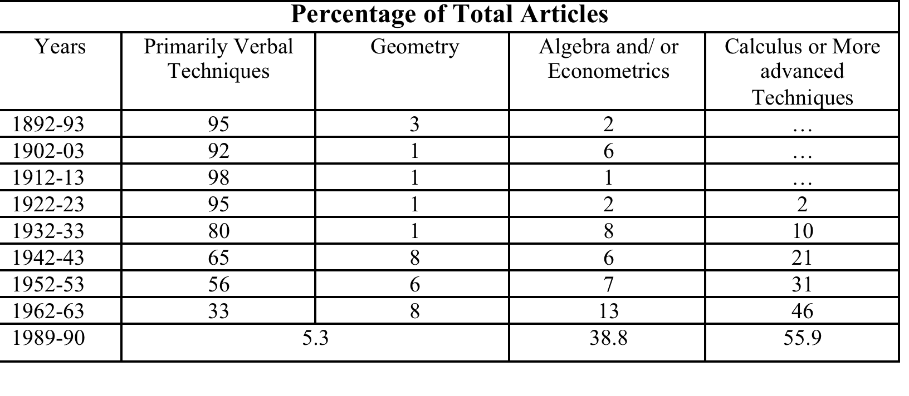
Techniques Used in Articles Published in Five Economics Journals
STIGLER J. George, Stephen M. Stigler & Claire Friedland, The Journals of Economics, 103 J. Polt. Econ. 331 (1995).

Slide 50
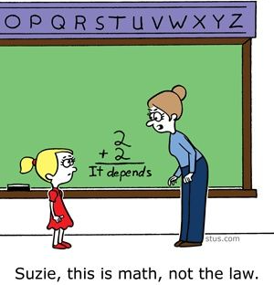

Slide 51
Do statistics lie
Alain Desrosières, The Politics of Large Numbers

Slide 52
Mathematical Paradigm in Law
« one can judge concerning just and unjust as incontestably as one can judge in mathematics » (New Essays)
Notes:
Consequently, he placed mathematics and physics in different realms of knowledge, each of them requiring different intellectual capacities. Aristotle, Nicomachean Ethics para. 1142a, at 16-19 (Hackett Publishing repr. 1999).

Slide 53
Mathematical Paradigm in Law
« if controversies were to arise, there would be no more need of disputation between two philosophers than between two calculators. For it would suffice for them to take their pencils in their hands and to sit down at the abacus, and say to each other (and if they so wish also to a friend called to help): Let us calculate. »
G.W. Leibniz (1646-1716)
Notes:
Consequently, he placed mathematics and physics in different realms of knowledge, each of them requiring different intellectual capacities. Aristotle, Nicomachean Ethics para. 1142a, at 16-19 (Hackett Publishing repr. 1999).

Slide 54
Leibnizian Project
Rationalization of the Law & of Legal Practice – Transform legal controversies into a problem of calculation
Preliminaries :
A formal and unequivoqual legal language
Characteristica Universalis : complete description of all the legal concepts
Ars Combinatoria: to enable the calculation of any true legal proposition
Build the table of every meaningful legal propositions
Notes:
Consequently, he placed mathematics and physics in different realms of knowledge, each of them requiring different intellectual capacities. Aristotle, Nicomachean Ethics para. 1142a, at 16-19 (Hackett Publishing repr. 1999).

Slide 55
This time it’s Different
Machine-Readable Law
Huge collections of data / Internet + IoT
Algorithms and Data Analytics
Feedback System

Slide 56
Machine-Readable Law
Open Law Data Movement : statutes, regulations and case-laws
Technical standards :
OASIS Legal XML
UNDESA Akoma Ntoso
CEN Metalex

Slide 57
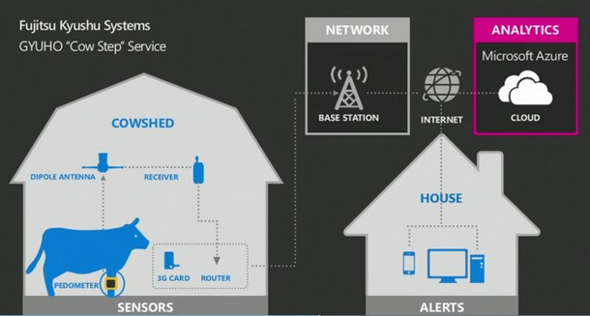

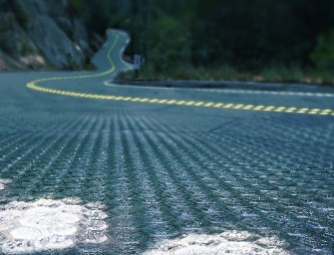
Huge collections of data

Slide 58
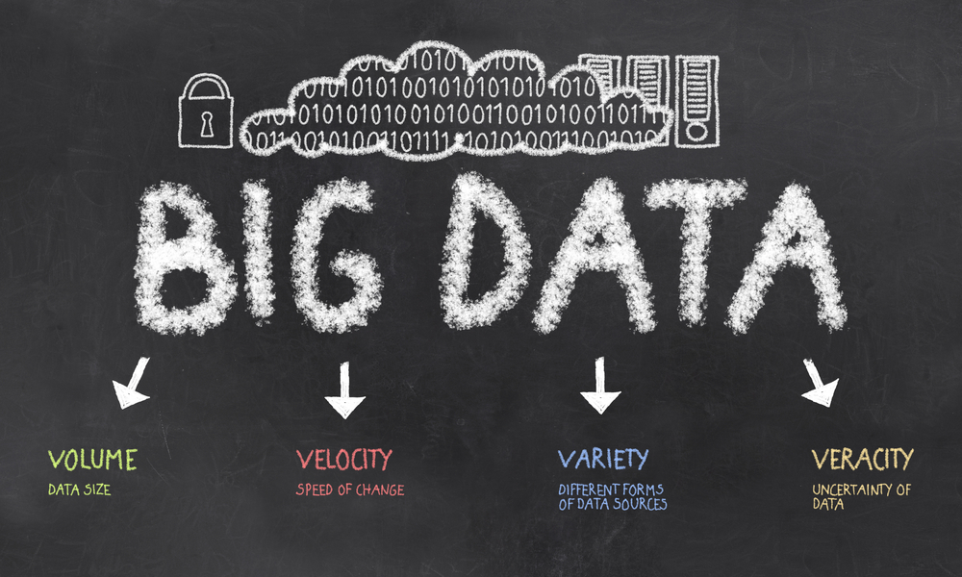
Algorithms and Data Analytics

Slide 59
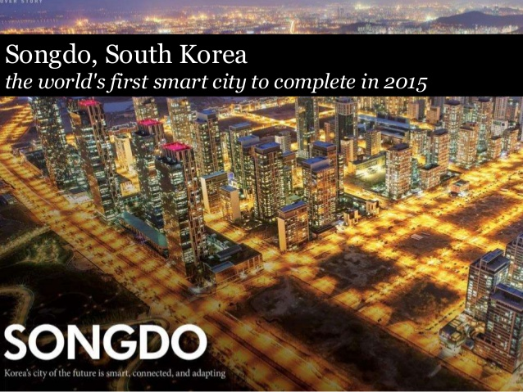
Feedback System

Slide 60
A technological Ecosystem

Slide 61
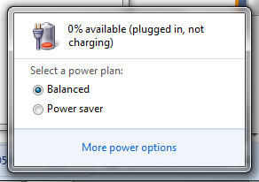
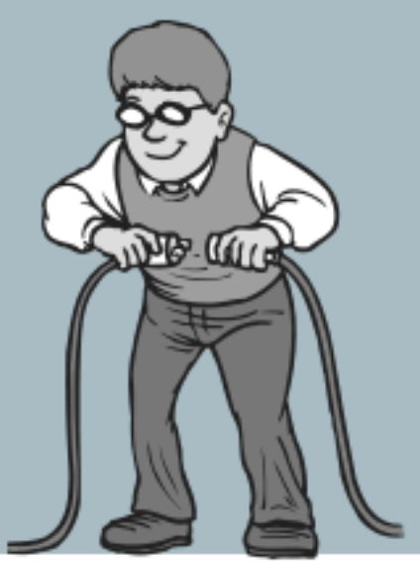
Disconnect?

Slide 62

In depth case study: Connect

Slide 63
Value of Tax Gap before Connect

Slide 64
Measure of non-compliance
Our tax gap is a complete measure of non-compliance with current tax law. It does not include a measure of how much additional tax might be collected if you changed the policy
HMRC (HC 666 of 2013-14 para 3 (fn 7), Ev25, Ev27)

Slide 65
Tax Compliance v. Tax Policy Gap
Source: IMF

Slide 66
Data Cycle
Data Collection
Analysis
Storage
Structured data storage for analysis
Data mining
Self-assessment Tax return
‘spider diagram’ visualisation tools
Risk profiling - lifestyle
Structured/unstructured data
Social network analysis
Analytical compliance environment (ACE)
Integrated compliance environment (ICE)
Data Acquisition and Networking (DAN)

Slide 67
Dataset
Visa and Mastercard transactions
Land Registry
Driver and Vehicle Licensing Agency
UK and overseas bank accounts: Internal tax documents (e.g council tax paid, relevant VAT registration, previous tax investigations, etc.)
Earnings (including child benefit and maintenance payments through the child support agency)
Online marketplaces (e.g. Airbnb, eBay & Gumtree)
Social media (Twitter, Facebook and Instagram
Internet connection record for 1 year
Notes:
Visa and Mastercard transactions: Anonymised information on all payments
Land Registry records: To determine properties purchased, and stamp duty paid
DVLA: Details of cars purchased and owned by individuals
UK and overseas bank accounts: From this year it receives information from banks in more than 60 countries.
Internal tax documents: Systems show council tax paid, relevant VAT registration, previous tax investigations, last year's tax return (or absence of one)
Earnings: From any employer, including those you have worked for casually, or on an ad-hoc basis. This includes any company benefits received. It can also access child benefit and maintenance payments through the child support agency
Online marketplaces: Websites such as eBay and Gumtree can be accessed to weed out regular traders
Social media: The Connect system can also look at public social media account information, including from Twitter, Facebook and Instagram
Web browsing and email records: Under the 'Snoopers Charter' HMRC will be able to access individual's digital information
An internet connection record (ICR) is a record, comprised of a number of items of communications data, of an event about the service to which a customer has connected to on the internet, such as a website or instant messaging application. It is captured by the company providing access to the internet. Where available, this data may be acquired from communications service providers (CSPs) by law enforcement and the security and intelligence agencies.
An ICR is not a person’s full internet browsing history. It is a record of the services that they have connected to, which can provide vital investigative leads. It would not reveal every web page that they visit or anything that they do on a web page.
Investigatory Powers Act 2016n Article 61 (7)f
Communication service providers can be required to keep ICRs for a maximum period of 12 months.
“for the purpose of assessing or collecting any tax, duty, levy or other imposition, contribution or charge payable to a government department”
https://assets.publishing.service.gov.uk/government/uploads/system/uploads/attachment_data/file/530556/Internet_Connection_Records_factsheet.pdf

Slide 68
Data Cycle
Data Collection
Analysis
Storage
Structured data storage for analysis
Data mining
Self-assessment Tax return
‘spider diagram’ visualisation tools
Risk profiling - lifestyle
StructureD data
Social network analysis
Analytical compliance environment (ACE)
Integrated compliance environment (ICE)
Data Acquisition and Networking (DAN)

Slide 69
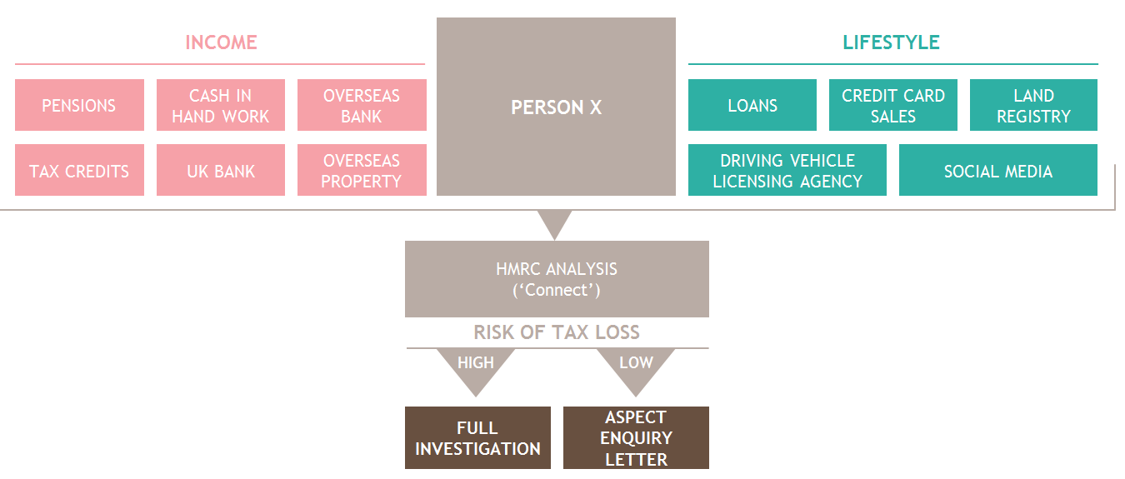
Social Graphs and Enforcement

Slide 70
This allows HMRC to build up a picture of someone’s financial worth and means that if someone is only declaring £20,000 a year, but is living a £100,000 lifestyle, HMRC can call on that individual to pay more
HMRC

Slide 75
Full Implementation
Data collection
Investigatory Powers Act 2016
Internet connection records (ICRs) will be able for analysis by Connect

Slide 76
Internet Connection Record (ICR)
An internet connection record (ICR) is a record, comprised of a number of items of communications data, of an event about the service to which a customer has connected to on the internet, such as a website or instant messaging application. It is captured by the company providing access to the internet. Where available, this data may be acquired from communications service providers (CSPs) by law enforcement and the security and intelligence agencies.
An ICR is not a person’s full internet browsing history. It is a record of the services that they have connected to, which can provide vital investigative leads. It would not reveal every web page that they visit or anything that they do on a web page.
https://assets.publishing.service.gov.uk/government/uploads/system/uploads/attachment_data/file/530556/Internet_Connection_Records_factsheet.pdf

Slide 77
Internet Connection Record (ICR)
There is no current requirement in law for CSPs to keep ICRs and this information may therefore be unavailable to law enforcement agencies, meaning that often they can only paint a fragmented intelligence picture of a known suspect.
Investigatory Powers Act 2016n Article 61 (7)f
Communication service providers can be required to keep ICRs for a maximum period of 12 months.
“for the purpose of assessing or collecting any tax, duty, levy or other imposition, contribution or charge payable to a government department”

Slide 78
Full Implementation
Data collection
Investigatory Powers Act 2016
Data processing
Analytics for Debtor Profiling and Targeting (ADEPT)
New risk profiling based on collected data and lifestyle and response to HMRC interventions (ground truth?)
Law enforcement
Finance (No. 2) Act 2015
Internet connection records (ICRs) will be able for analysis by Connect
Direct Recovery of Debts (enforcement by deduction from accounts)

Slide 79
Possible Contestations?
Provide an advice to client as to key precautions to implement?

Slide 80
Possible DS contestations

Slide 81
Takeaways Connect & Manual Examination
Connect enables HRMC to open investigations based on serious indicators of fraud (analysis of structured and unstructured data)
The software limits the power of judgment of the tax inspector
At the level of target selection : difficult to justify ruling out the examination of a case identified by the software (93% of the tax enquiries followed an indication by Connect)
At the level of the interpretation of tax law : the algorithms incorporate a certain interpretation of the legal rules, based on which they extract and analyze data
Eventually, at the level of law enforcement : it is planned for the software to prescribe the amount that the taxpayer ought to pay by directly applying the tax rules to the factual data collected

Slide 82
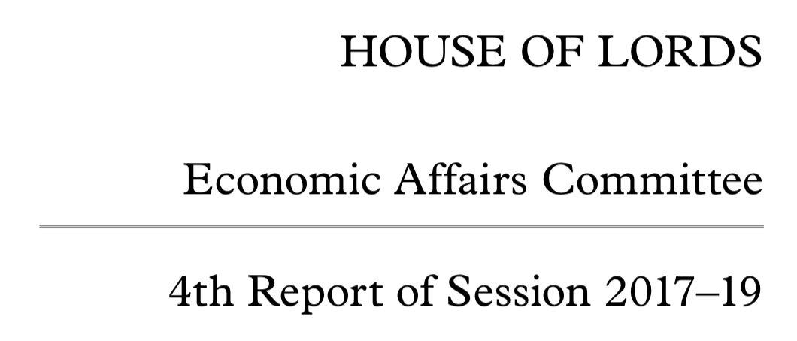

Consequences

Slide 83
Does Connect Change the Law ?
Formalist Approach : No.
Pragmatic Approach : Yes.
If you want to know the law and nothing else, you must look at it as a bad man, who cares only for the material consequences which such knowledge enables him to predict, not as a good one, who finds his reasons for conduct, whether inside the law or outside of it, in the vaguer sanctions of conscience
O.W. Holmes, The Path of the Law, 1897.
« the life of the law is in its enforcement »
(R. Pound, « The Limits of Effective Legal Action », 1917.

Slide 84
How does Connect Change the law ?
Connect :
Defines the scope of relevant information
Identifies taxpayers to be audited
Applies a certain interpretation of tax law to determine the tax bill
In the process from data collection to evidence-based decision-making the rules are, in fact, replaced by the standards implemented by the software and the fraud indicators that it uses determine the standards to be complied with
As a consequence, taxpayers adapt their behavior and reasoning to this context in their disputes with the Treasury Department

Slide 85
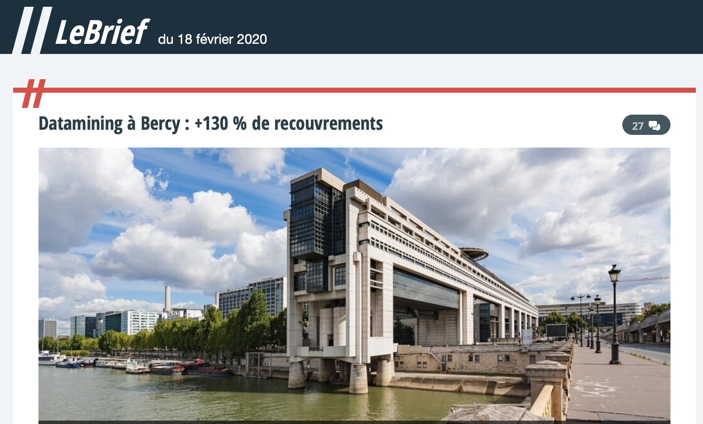
France? l'algorithme baptisé CFVR
Algorithm: Ciblage de la fraude et valorisation des requêtes.
Tested on 5 millions companies and expanded to 37 millions tax payer groups (foyers).

Slide 86
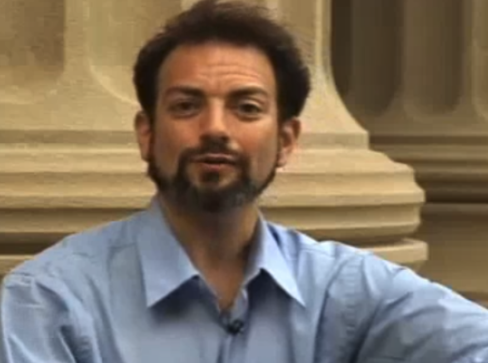
Guest talk – Computational law
Dazza Greenwood, a lecturer and research scientist at the MIT Media Lab, conducts research projects on big data, identity federation and trust frameworks with 2013/2014 academic year research focus on defining and developing "Computational Legal Science" as a sub-discipline of computational social science. Dazza leads the CIVICS.com consultancy, providing solutions at the intersection of business, law and technology for the innovation economy. Dazza also serves as the Vice Chair of the Plenary for the Identity Ecosystem Steering Group (IDESG of NSTIC), which is developing a framework for federated identity and privacy at the international level. Dazza has consulted to fortune 100 companies, including the insurance industry and financial services sector, architecting the creation of trust frameworks.
Editor of the Computational Law Report

